Slide 1
Treatment Plan and Beyond
Elizabeth Sullivan, Group Product Manager, CureMD
Notes:
Hi everyone – I’m Elizabeth – Group Product Manager for the Clinical side for CureMD.
We came out with the Treatment Plan last year. The providers in the CAP provided us with a lot of feedback while it was getting developed. A lot of our PH clients were Beta clients and helped us develop it further with specific workflows for the PH sector like the integration with the Inventory Rx Scanner barcode workflow that I showed in the Enhancing Clinical Effectiveness and Decrease Admin Burden section.
Our initial premise for the Tx Plan was to simplify the overall diagnosing and ordering process for the provider. So the Assessment and Plan part of the SOAP note. Currently – you have to go into multiple clinical components and multiple screens to order medications, labs and radiology procedures.
With the Tx Plan you can place all of your orders on a patient and sign off on them all together.
We know there were glitches in the Tx Plan when it was first rolled it out. You have told us what you need and our team has been working diligently on fixing any glitches and building out those workflows to enhance your entire EMR documentation experience.
In this session, I want to briefly review what we currently have in CureMD for the Treatment Plan and the changes we are making in the near future to it to make it better for you.

Slide 2
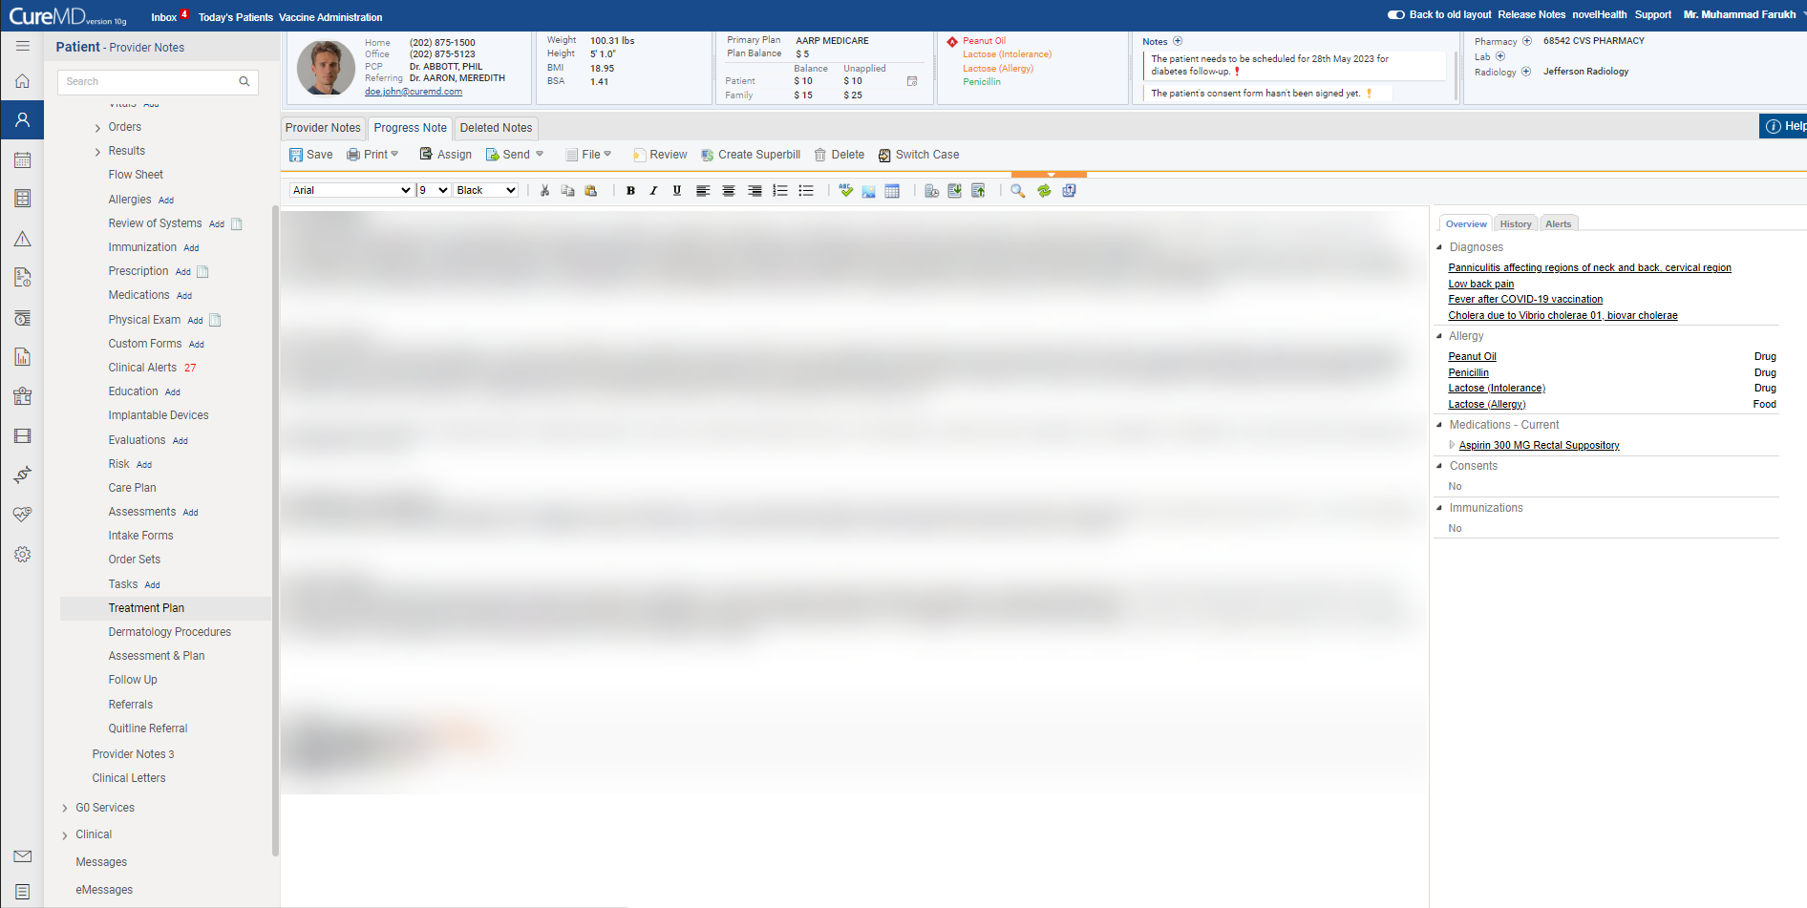
Notes:
Currently- when the user is in the provider note they can launch into the Tx Plan from the left side navigator or add the Tx Plan as a Link on their provider note.
When you click the link, you launch into the Tx Plan.

Slide 3
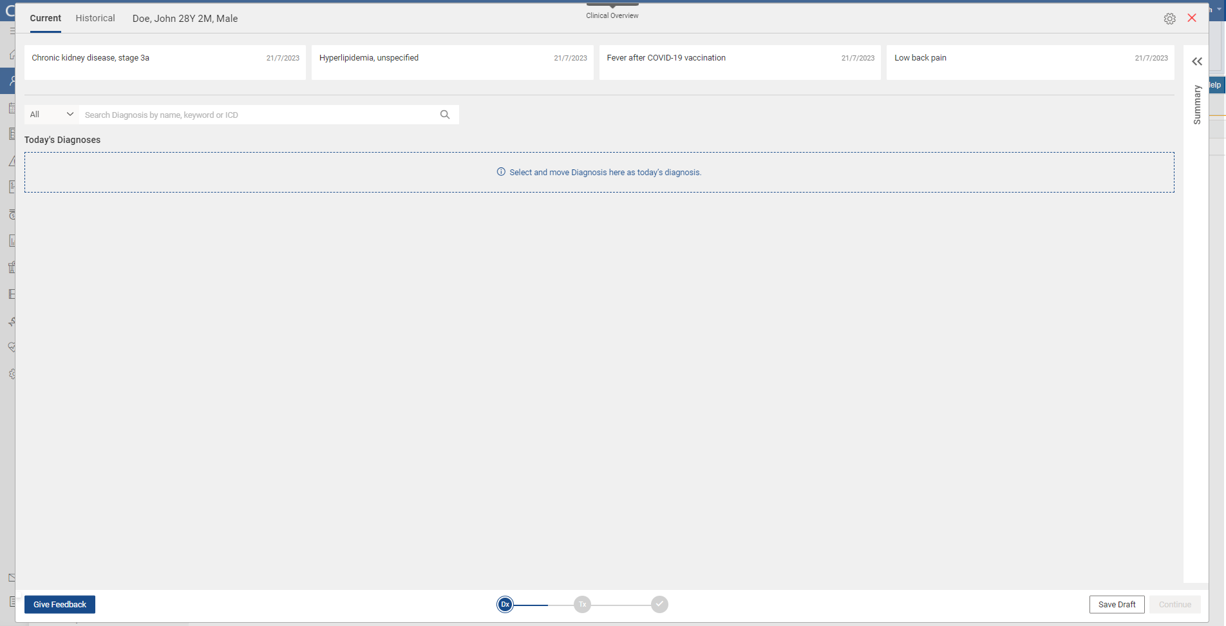
Notes:
Here you have the patient’s Current and Historical Diagnoses. You can easily drag and drop a current diagnoses down into Today’s Diagnoses.
You can also search on ALL Dx or Favorite Dx to find the Dx that you are looking for.
We recently went with a new terminology vendor that uses provider friendly terminology to help clinicians search and find a Dx.
This is a big improvement because instead of having to search by the ICD-10 coding verbiage – the user can search by their known clinical terminology that they are very familiar with.

Slide 4
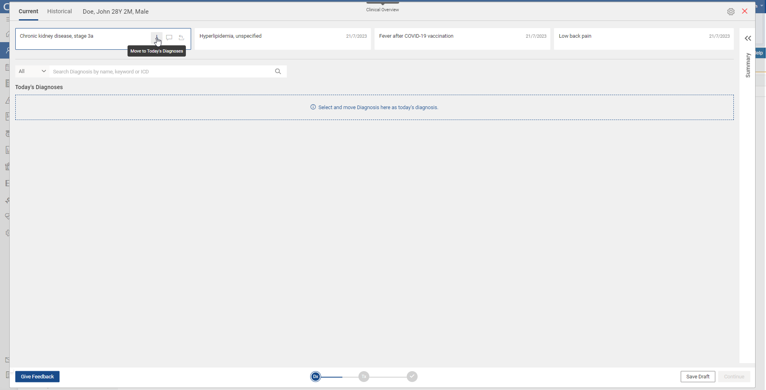
Notes:
This is just showing how you can move a current Dx into the Today’s Diagnoses space.

Slide 5
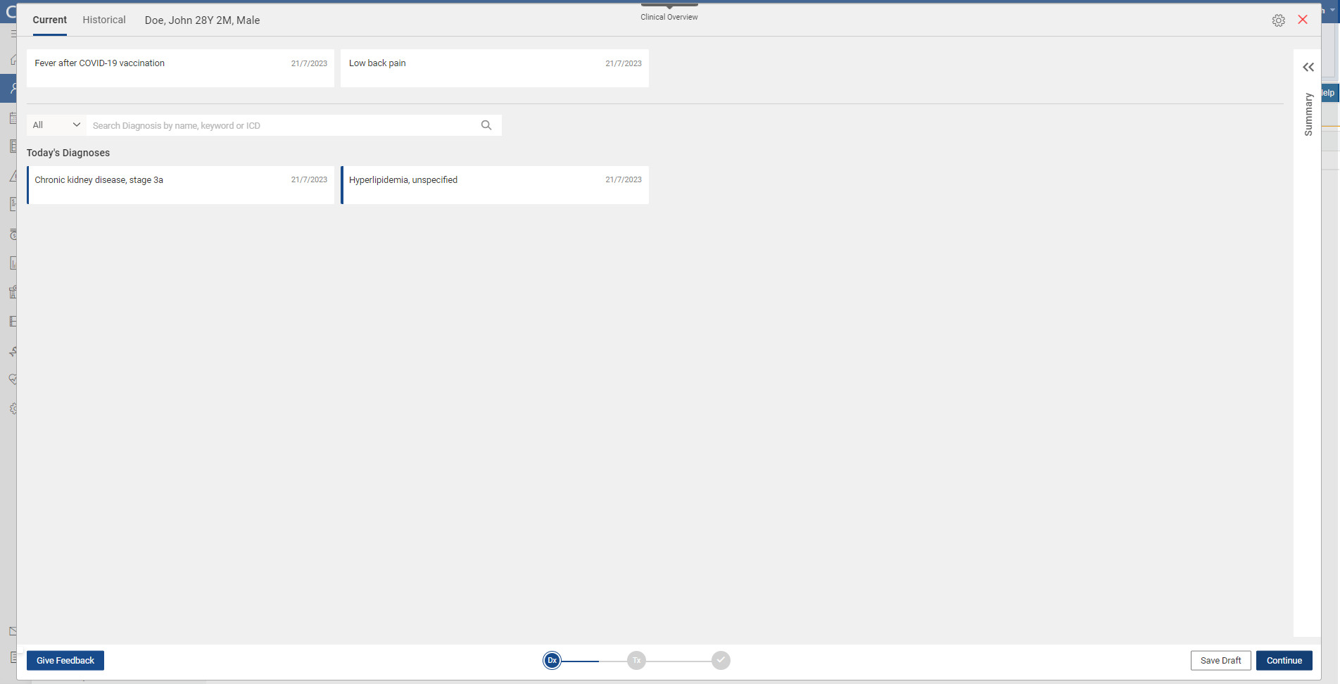
Notes:
Once you have selected your Diagnoses for Today , you can hit Continue.

Slide 6
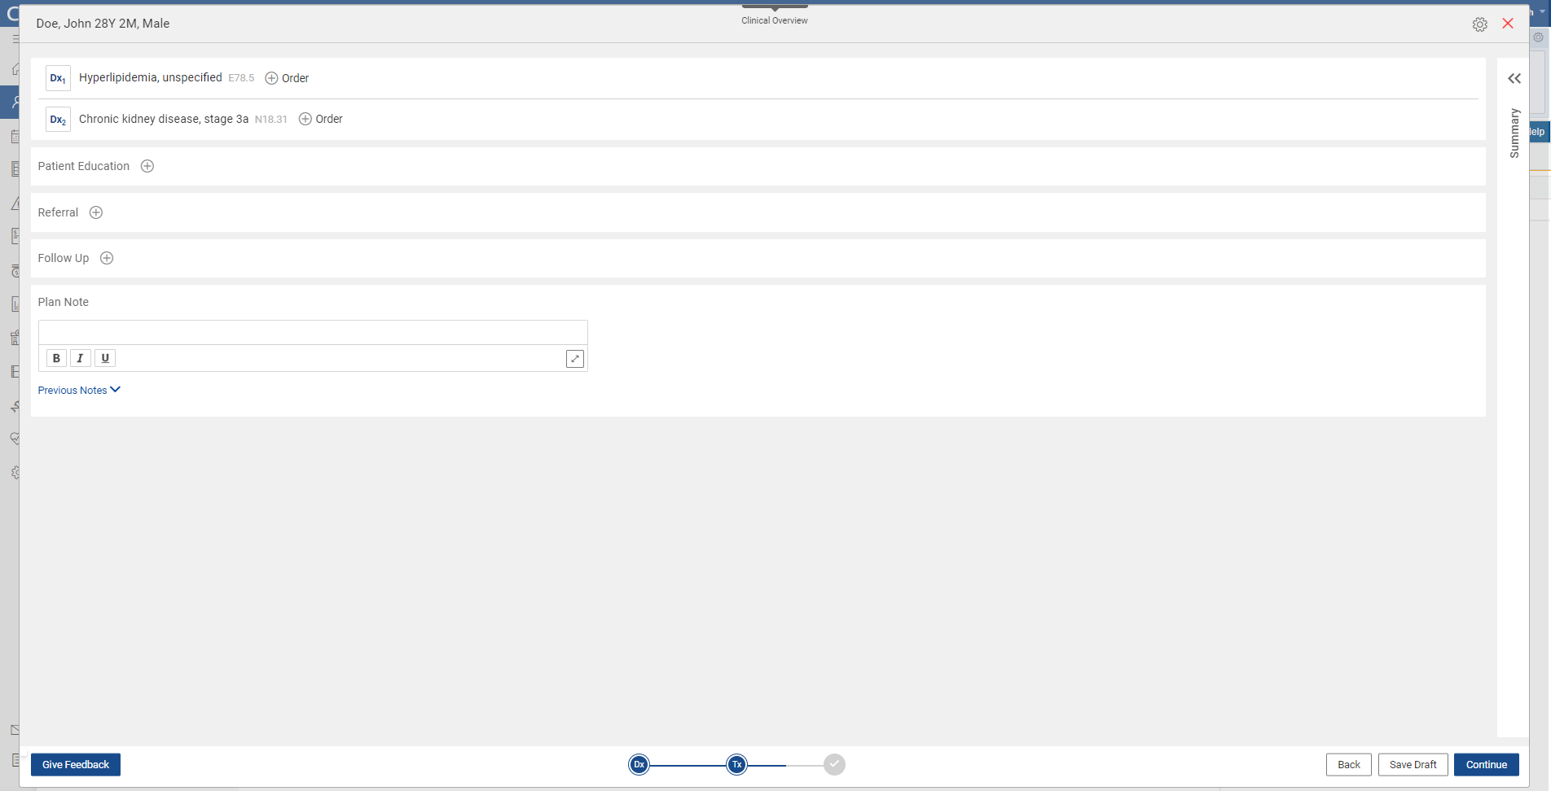
Notes:
Initially, we built the Tx Plan on the premise that the provider would want to associate their orders to a particular Diagnosis. We know that some laboratories even require this when sending off the specimen.
By doing this, We were able to analyze the provider’s ordering behavior and create Dx specific ordersets for that provider based on their ordering behavior. So the next time you wanted to place orders on a particular Dx- your previous orders would display under the ‘Frequent’ used category.
However, we heard from our providers and know that sometimes you do not want to associate orders to a particular Dx, so we have now given the user the ability to add orders on the fly into the Tx Plan without having to associated it with a Diagnosis.

Slide 7
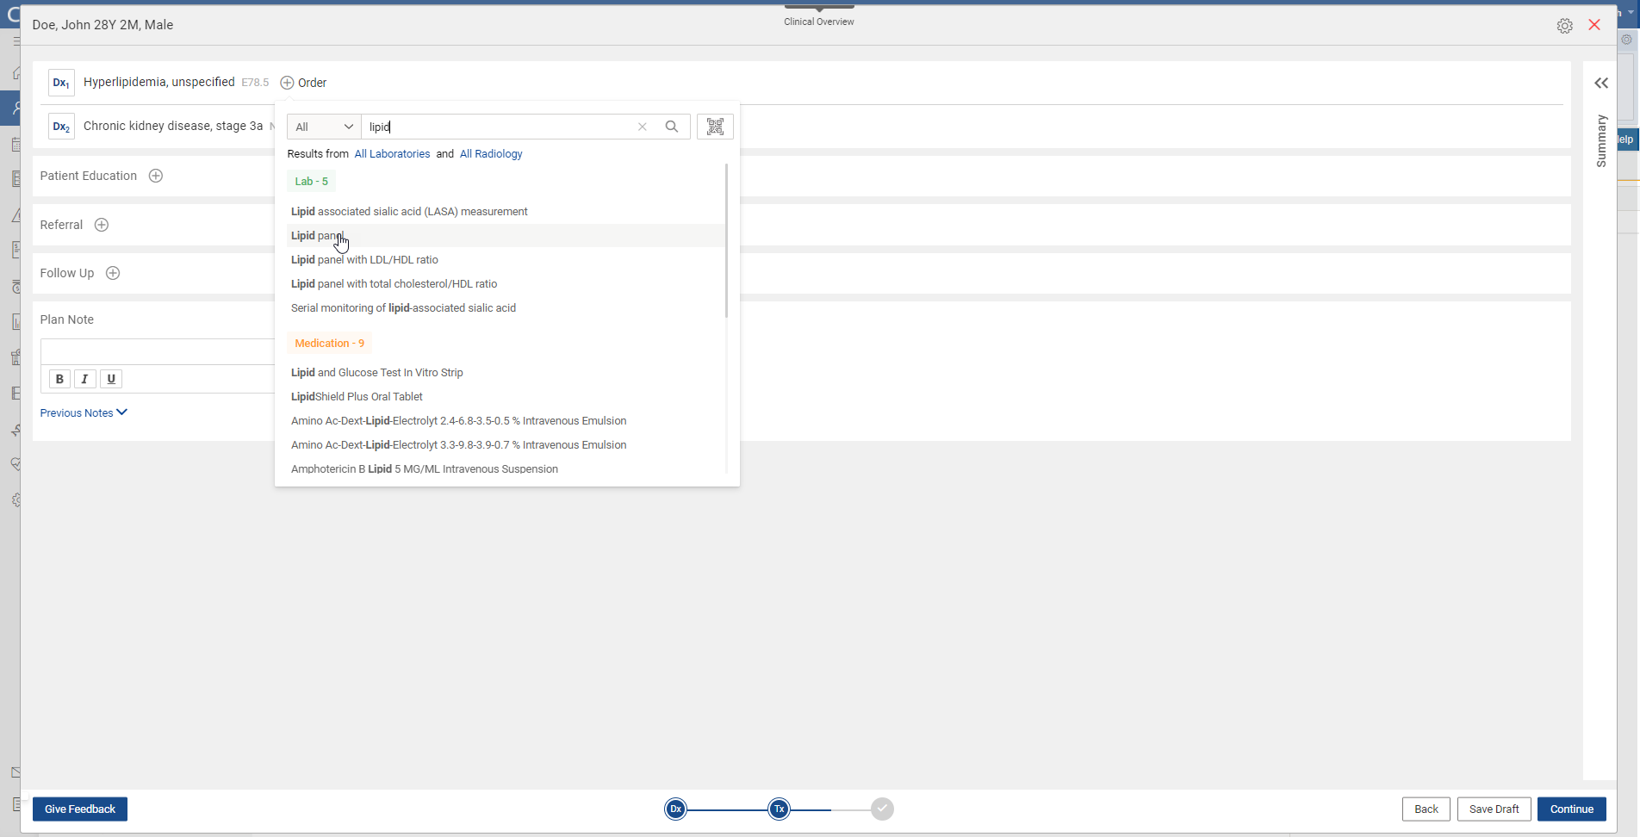
Notes:
So here you can see we are ordering a Lipid panel on the patient and putting it towards the hyperlipidemia Dx.
With the new terminology vendor the search results that come back are more filtered and tailored to your search criteria.

Slide 8
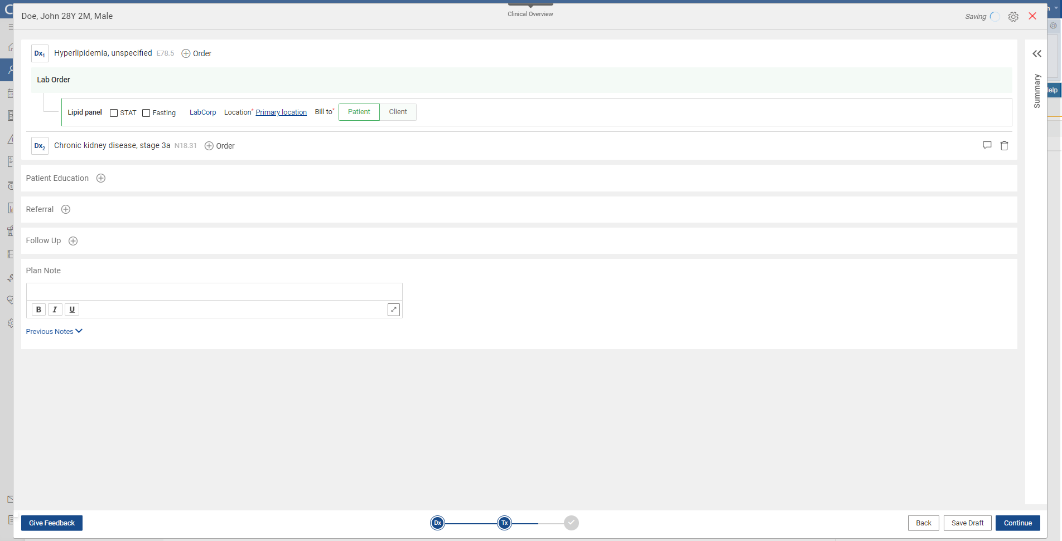
Notes:
We streamlined the ordering process in the Tx Plan as well. A lot of the values will default in the fields to make it easier when ordering medications.

Slide 9
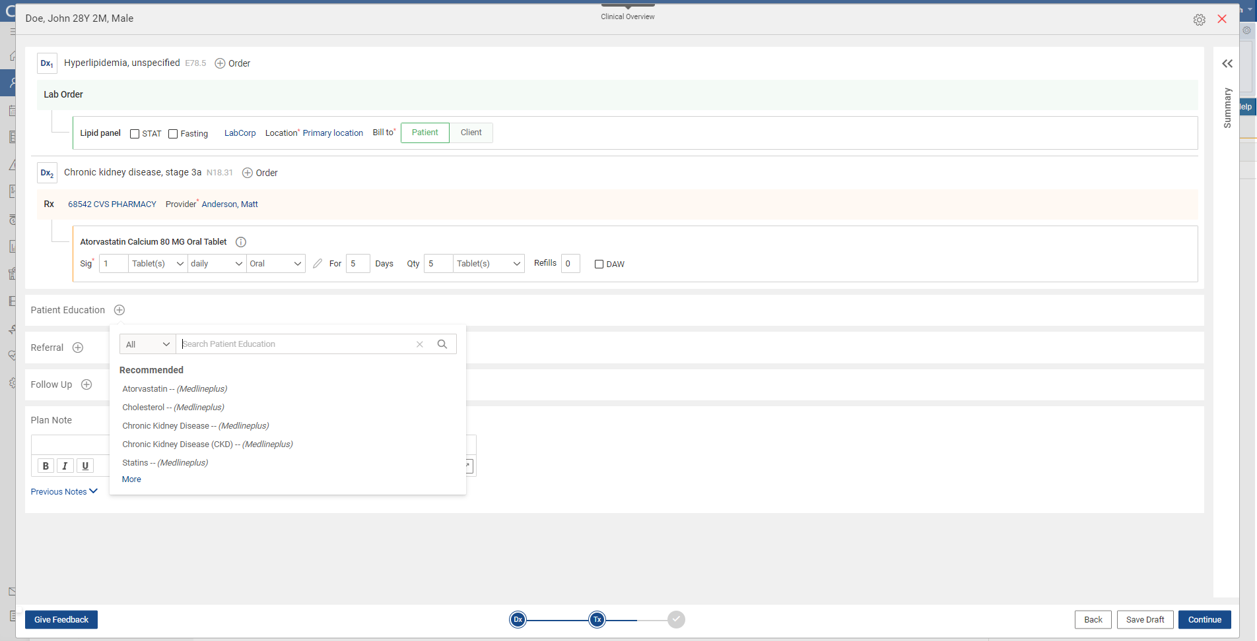
Notes:
Once you’ve completed your ordering you can then move onto the patient’s education. We have a partnership with Medline Plus. We are also looking at Healthwise educational materials.

Slide 10
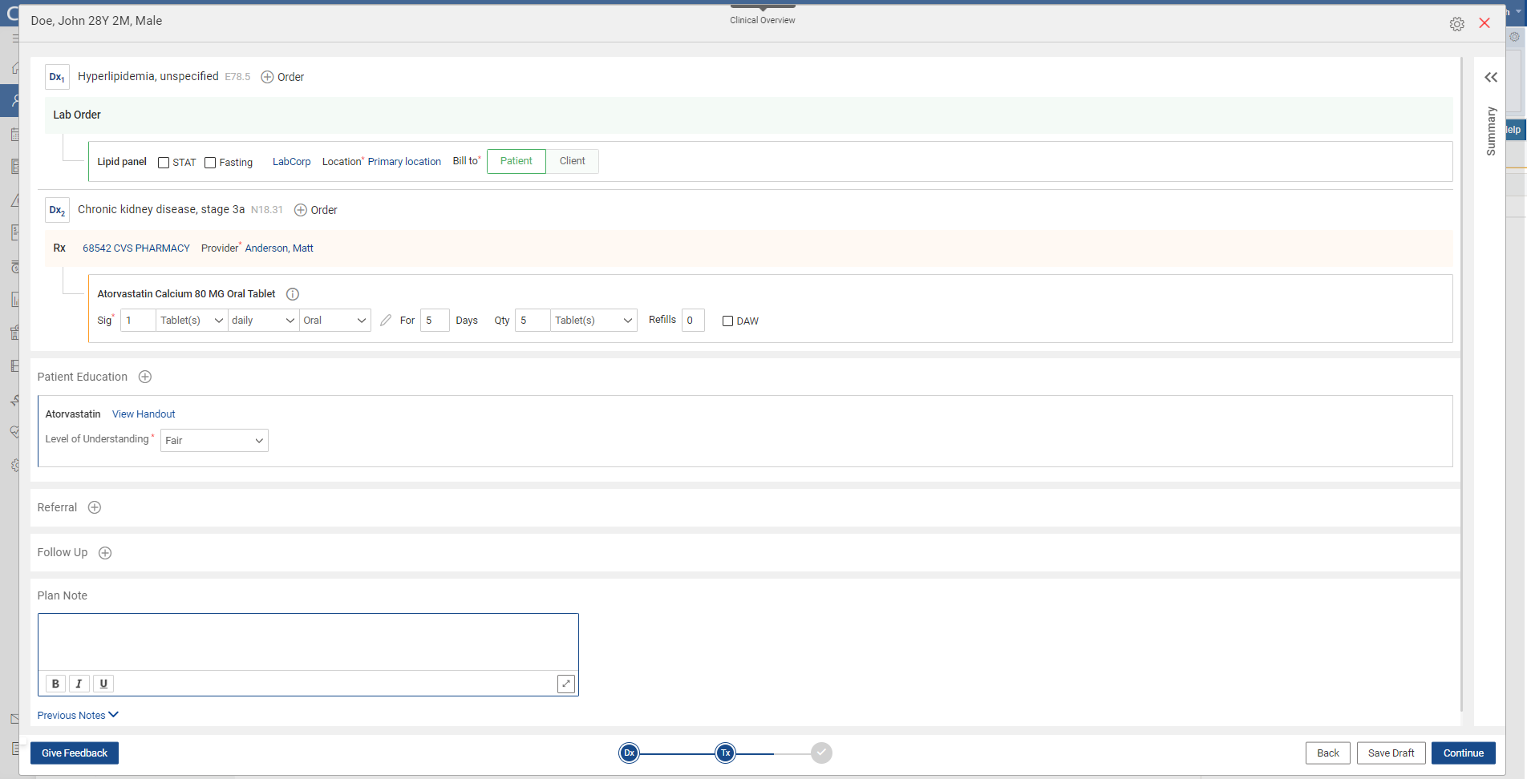
Notes:
Fill in the fields on the level of learning for the education.

Slide 11
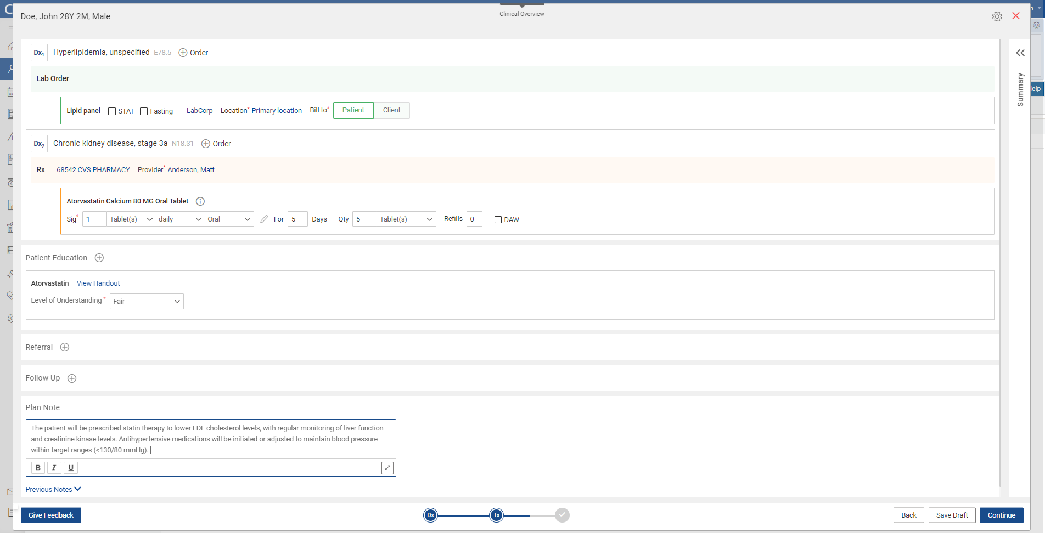
Notes:
Then you can free text in your Plan Note. Look at having macros to fill in the verbiage for the Plan so you don’t have to type it out or copy/paste it every time.

Slide 12
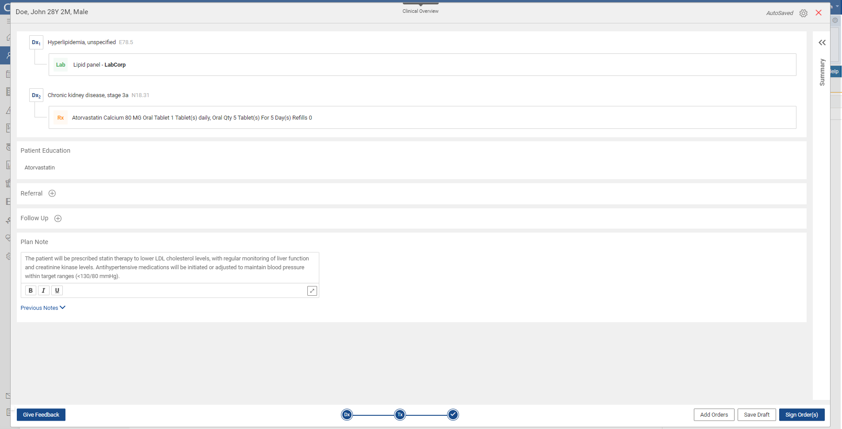
Notes:
Then you can do a Final Review of all your orders and the Plan before you Sign the Note.

Slide 13
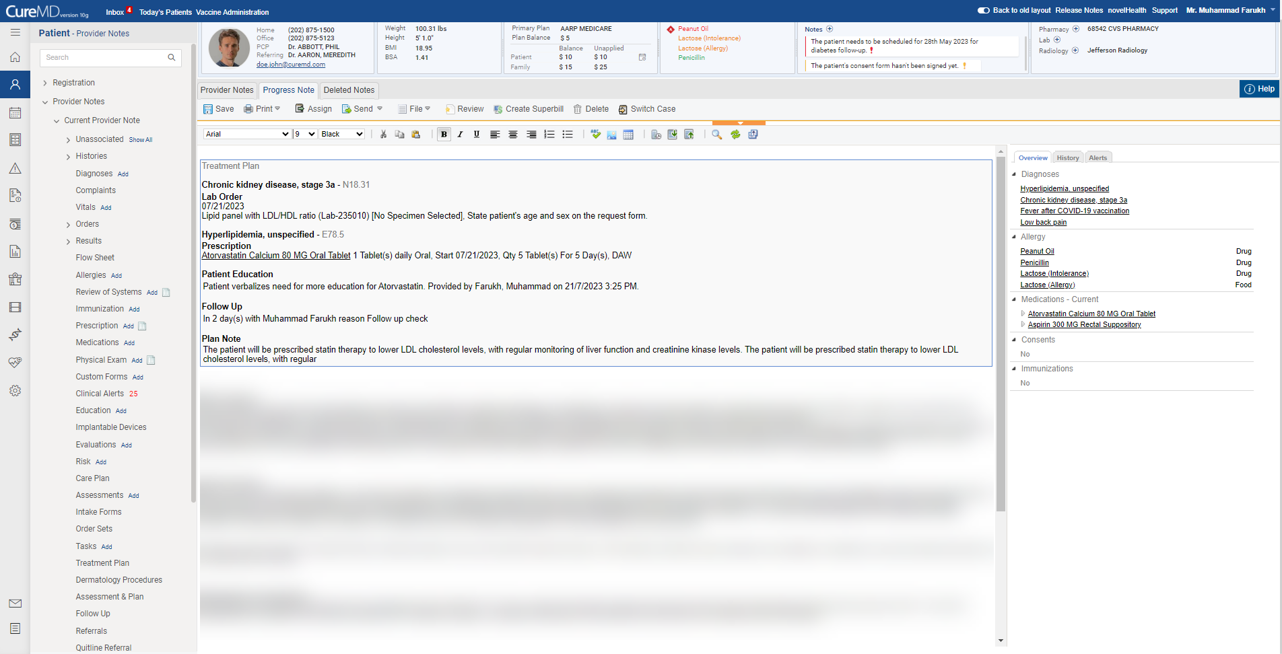
Notes:
This is what the Tx Plan Note looks like on the Provider Note Screen – very clean look and feel.

Slide 14
Phase II Treatment Plan
Notes:
So we heard from you all – the PH sector have been some of our best Beta clients for the Tx Plan and have told us what they need in order for this to be successful.
In this section, I want to discuss the changes we made to the Assessment and Plan section of the Treatment Plan.

Slide 15
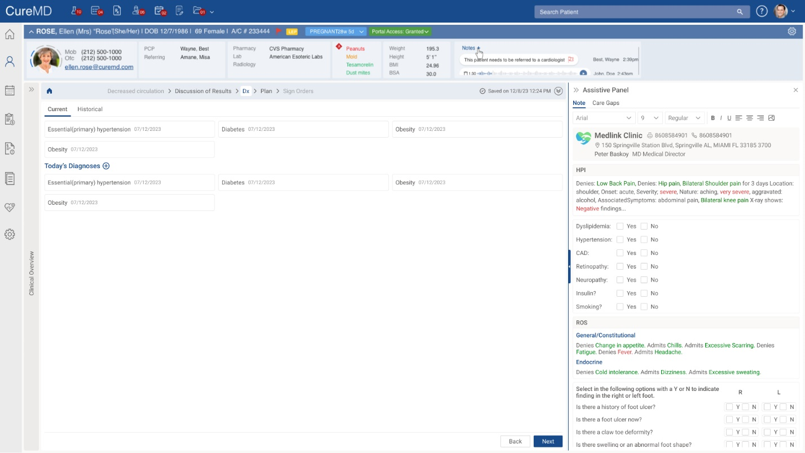
Notes:
As Kristina had mentioned yesterday, we have made some big enhancements to the Provider Note.
The Tx Plan will be intuitively designed into the flow of the Provider Note. You no longer have to launch out into the Tx Plan from your Provider Note template anymore.
After the provider has charted on the Patient’s HPI, ROS, PE (whatever components they have on their Template)– they will intuitively be navigated to the Diagnosis screen of the Tx Plan.
So- It’s just one smooth workflow for the charting your entire SOAP Note in one sitting.
You’ll also notice that the flags for the components for your Provider Note will be at the top of the screen so you can easily toggle back and forth between components if you forget to document something in your provider note assessment.
You can also add and remove assessments on the fly.
You’ll also notice that what you just charted on your Provider Note will be seen in narrative format on the right hand panel to view as you’re completing your Assessment and Plan for the patient. So you’ll know in advance what your provider note narrative will say.
You can make the right hand panel larger for easier viewing.
In addition, there will be a tab for Care Gaps Detection - that will identify gaps in your charting based upon your clinical quality measures (AI driven).
Just like before with the Tx Plan – When the user is on the Dx screen, the user can drag or drop a current Dx into Today’s Diagnoses section or can search and find a new Dx or select one of your Favorites from your Favs list.
Once the diagnoses are selected for the encounter, clicking Next (bottom of the screen) will take you to the Orders screen.

Slide 16
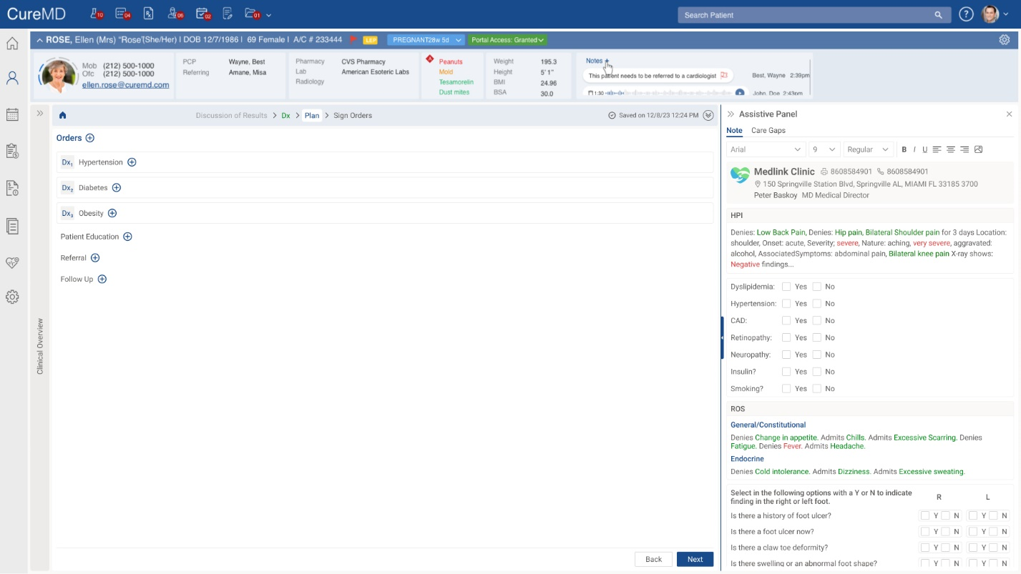
Notes:
You can now add Orders without associating them to a particular Diagnosis. We heard our providers that this was a pain point so we wanted to give you both options. If you want to associate your orders to a Dx you still can but you don’t have to in order to move to the next screen.

Slide 17
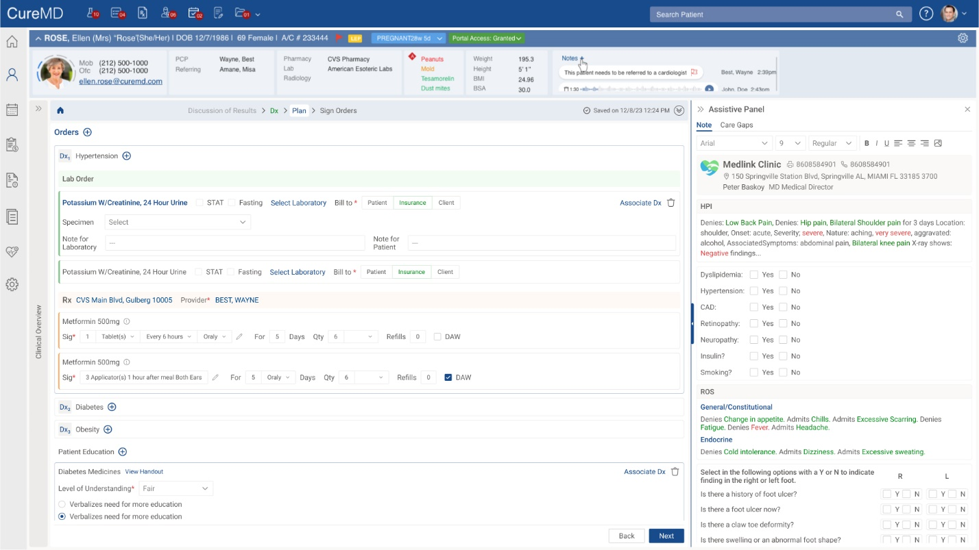
Notes:
Once all orders are added and the order details are done - you can add in the patient’s education and plan of care.

Slide 18
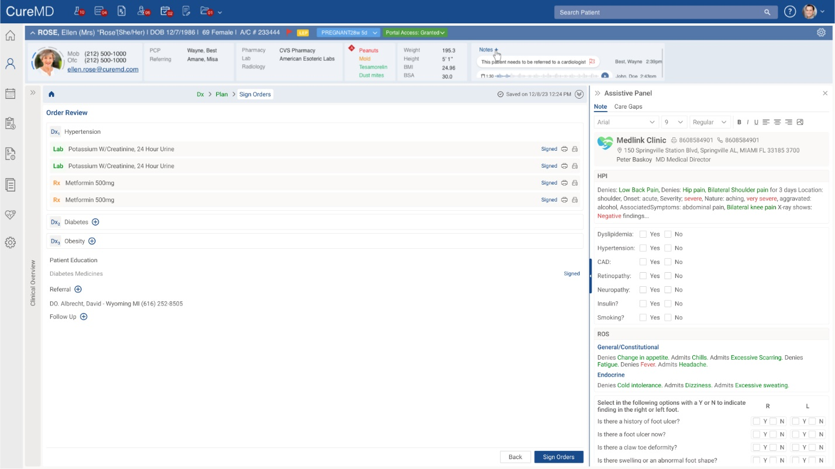
Notes:
After a final review of the Orders you can sign off on them.

Slide 19
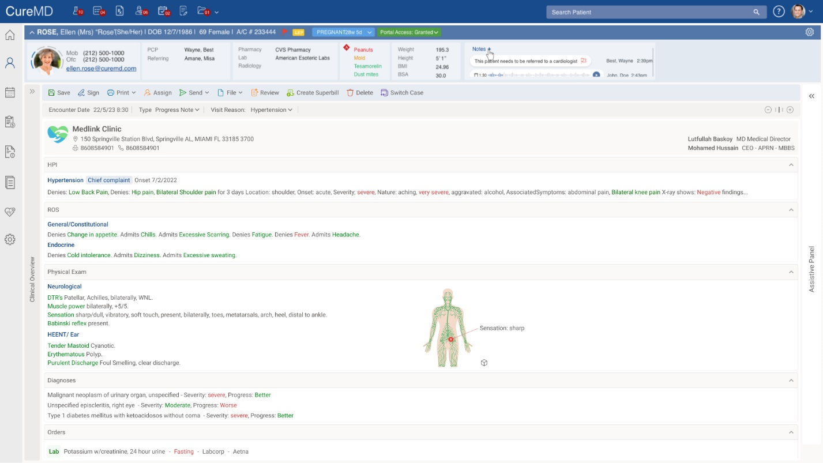
Notes:
Once you sign off on the Orders, it brings the user to the SOAP Text for the entire encounter.

